Slide 1

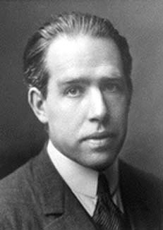
BOHR'S ATOM MODEL
Niels Henrik David Bohr. (1884-1962)
In 1913, Bohr suggested his atom model for which he was awarded Nobel Prize for Physics in 1922
Notes:
What is RADAR an acronym for? Radio Detection and Ranging.
Radio wave is generated, transmitted, reflected, and detected.
RADAR unimpaired by night, fog, clouds, smoke.
Not as detailed as actual sight.
RADAR is good for isolated targets against a relatively featureless background.

Slide 2

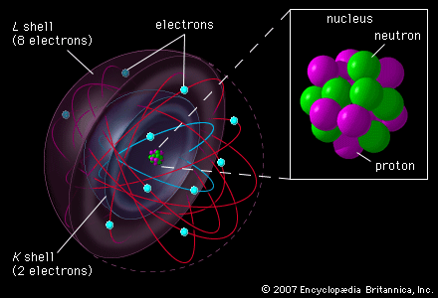
BOHR'S ATOM MODEL
1
Positively charged nucleus are at the centre and negatively charged electrons revolve round the nucleus in various circular orbit.

Slide 3

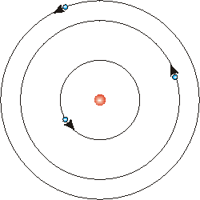
BOHR'S ATOM MODEL
Energy level
2
The electrons revolving round the nucleus only in certain permitted orbits are called energy levels. i.e. orbits of certain radii are allowed.
Notes:
3

Slide 4
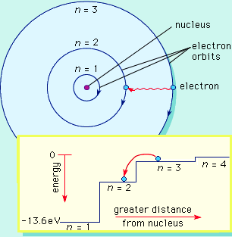
BOHR'S ATOM MODEL
3
Each energy level has a certain fixed amount of energy. The larger the orbit (i.e. larger radius), the greater is the energy of electrons.
Notes:
4

Slide 5
BOHR'S ATOM MODEL
4
Electrons gives out energy in the form of electromagnetic radiation when it jumps from higher to lower level.
Notes:
5

Slide 6
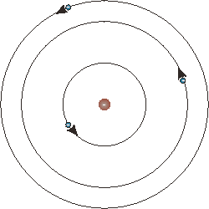
BOHR'S POSTULATES OF H
Electron
Nucleus
1
An atom consists of positively charged nucleus at the centre
Notes:
6

Slide 7
BOHR'S POSTULATES OF H
2
Electron
The negatively charged electrons move round the nucleus in various orbits known as stationary energy levels.
Nucleus
The electrons can’t emit radiations when moving in their own stationary level
Notes:
7

Slide 8
BOHR'S POSTULATES OF H
3
The Coulombian and Newtonian forces are applicable in the domain of the atom
Electron
Nucleus
Coulomb force
4
The angular momentum for electron mvr = nh/2π
Notes:
8

Slide 9
BOHR'S POSTULATES OF H
W_{n3}
5
When an electron jumps from a higher energy level to a lower energy level, it gives out EM radiations of a particular frequency
W_{n2}
hv
W_{n1}
W_{n2} – W_{n1} = hv
Notes:
9

Slide 10
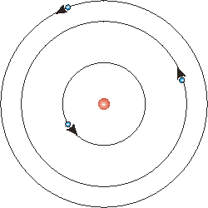
CALCULATION OF RADIUS
Let us consider an atom having mass m
Nucleus of charge E = Ze
Electron of charge = e
Radius of an orbit = r
The electrostatic force of attraction
F_{e} = Ee / 4πε₀ r² ….. (1)
The centripetal force
F_{c} = mv²/ r …………(2)
n₃
n₂
Electron
n₁
e
Nucleus
r
E
The condition for dynamically stable orbit is F_{e} = F_{c}

Slide 11
CALCULATION OF RADIUS
mv²/ r = Ze² / 4πε₀ r²
mv² = Ze² / 4πε₀r ………(3)
We know, the angular momentum,
mvr = nh / 2π
or, v = nh / 2πmr ……(4)
Eqn (3) becomes
m( nh/2πmr)² = Ze² / 4πε₀r
r = ε₀n²h² / πmZe² ….(5)
n₃
n₂
Electron
n₁
e
Nucleus
r
E
This is the eqn for radius →
r = ε₀n²h² / πmZe²

Slide 12
CALCULATION OF RADIUS
From eqn (5) r ∞ n²
So the radii are in the ratio of 1 : 4 : 9 : 16 etc . From equation (5) the radius of the first orbit of hydrogen r = 5.29 x 10⁻¹¹m, where n =1 and Z = 1
Substituting r in eqn (4)
v = Ze² / 2ε₀nh
n₃
n₂
Electron
n₁
e
Nucleus
r
E
v = Ze² / 2ε₀nh
This equation shows that v is inversely proportional to n

Slide 13
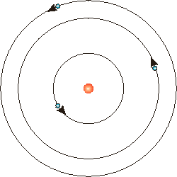
CALCULATION OF ENERGY
The energy is partly potential and partly kinetic
The potential energy of electron =
n₃
n₂
n₁
Electron
e
Nucleus
r
E
And kinetic energy of electron

Slide 14
CALCULATION OF ENERGY
Total energy E = P.E + K.E
n₃
n₂
n₁
Electron
e
…….(7) Now from eqn (5) & (7)
Nucleus
r
E
When an electron jumps from energy level n₂ to energy level n₁

Slide 15
CALCULATION OF FREQUENCY
Again we know
W_{n2} – W_{n1} = E = hv
n₃
n₂
n₁
Electron
e
Since C= υλ & Z=1 for H₂
Nucleus
r
E
Where υ = 1/λ = Wave number R= Rydberg constant

Slide 16
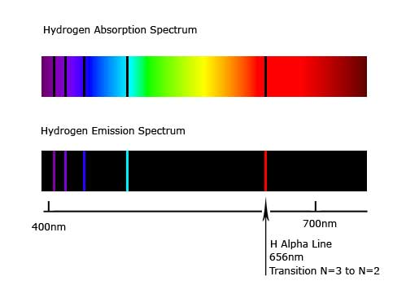
FAILURE OF BOHR MODEL
There is an ad hoc nature in the assumptions of Bohr where the quantum ideas of the stationary orbits is mixed up with the classical idea of Coulomb force.
1
It can not explain the origin of the fine structure of the spectral lines.
2
3
Though it can explain the spectral lines of H₂ but it can not explain the spectral lines of multi-electron systems like Helium.

